Slide 1
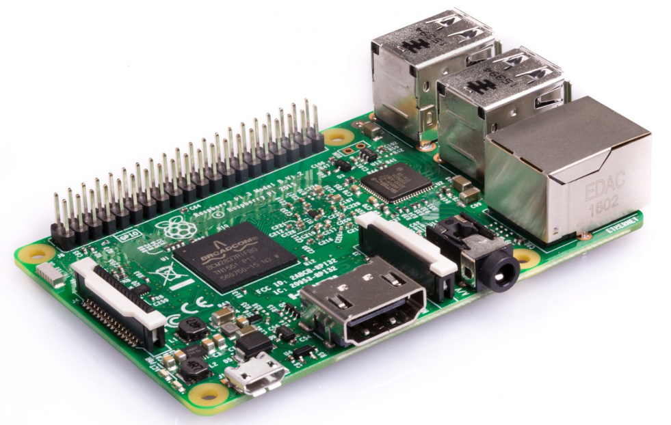
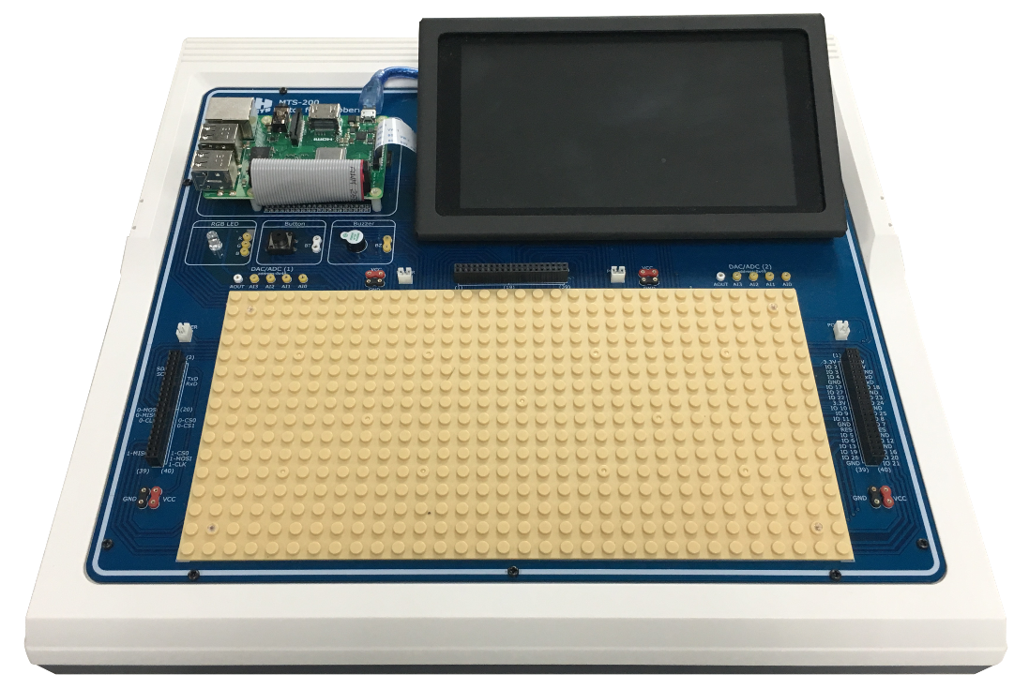

MTS-200
Tutor for Raspberry Pi
K&H MFG. Co., LTD.
Manufacturer, Exporter & Importer for Educational Equipment & Measuring Instrument

Slide 2

Features
Based on Raspberry Pi, users can learn the control of various kinds of I/O peripherals.
High degree of freedom and expendability: the system can be integrated with faya electronic block modules, modular electronic building blocks, high degrees of freedom and expansion
The experiment manual is based on Python programming language, with step-by-step experiment procedures.
With an independent power supply, users can freely increase/decrease peripheral modules.
3 sets of extendable I/O ports are located around the working area for easy signal connection.
2 additional independent DAC/ADCs are included for users to design more experimental circuits
A touch screen is built in for direct controlling and monitoring.

Slide 3
Specifications
I/O control with parallel UART, serial I2C and SPI
Sensing and driving circuits are included
Ethernet and 2.4GHz and 5GHz wireless networks are included
Bluetooth 4.2 and Bluetooth Low Energy (BLE) are included
Build in touch screen
With a 3.5 mm audio terminal for I/O control
With HDMI output terminal
With camera I/O control circuit

Slide 4
Specifications
Power
Input ：AC 110/220V, 50/60Hz
Output ：+5V / 3A, +3.3V / 1A
Control Board
Raspberry Pi 3
Memory card ：16G micro SD
Power：built-in USB power

Slide 5
Specifications
Display
Size：7-inch, touch screen
Resolution：800 x 480 @60fps，24-bit color
Protection : Metal frame with protective sticker
Prototyping Area
Device：RGB LED, Push button, Buzzer
ADC/DAC：2 sets, address：0x48, 0x49
NXP PCF8591, 8-bit resolution, analog input x 4, analog output x 1

Slide 6
Specifications
Power Jack ：+5V/GND Jump Wire Socket x 4
+5V/GND Wafer Socket x 4
I/O Socket： 40-pin female connector x 3
Brick Plate ：32x16
Note:
(1) A standard USB keyboard and mouse are required to complete all experiments (locally prepared).
(2) It is highly recommended to use a standard HDMI screen for the best training experience.

Slide 7
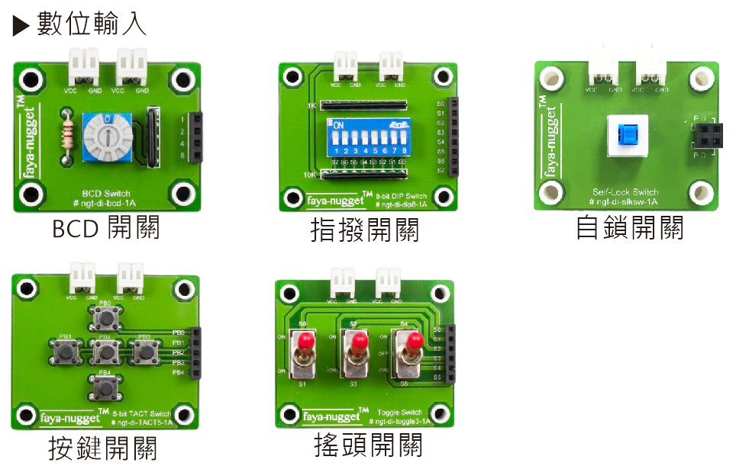
faya-nugget
Digital input
BCD Switch
8-bit DIP switch
Self-lock switch
5-bit TACT switch
Toggle switch

Slide 8
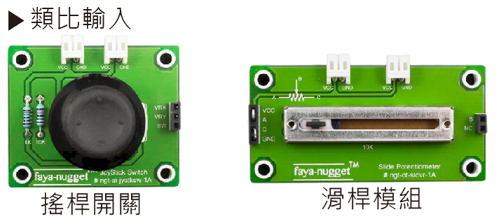
faya-nugget
Analog input
Joystick Switch
Slide Potentiometer

Slide 9
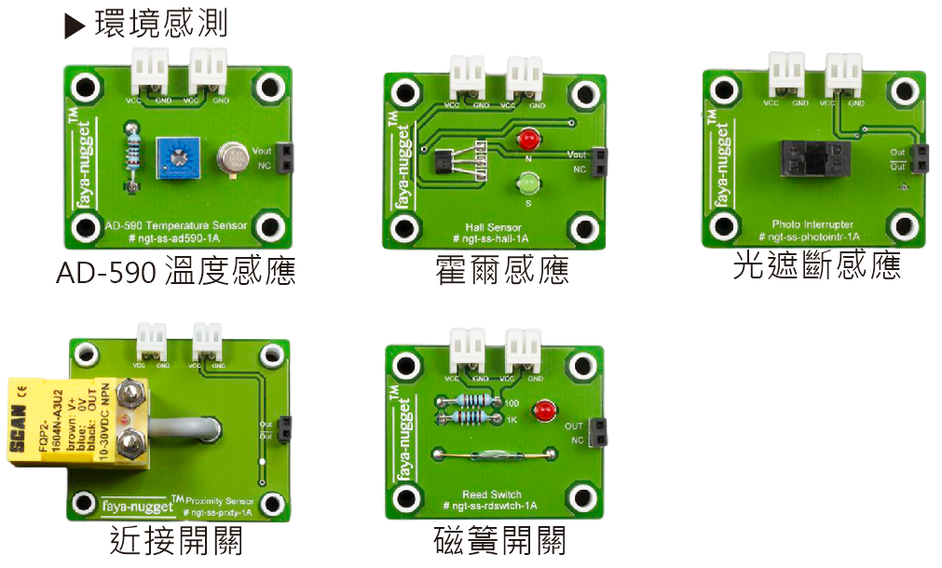
faya-nugget
Environment Detection
AD-590 Temperature
Sensor
Hall Sensor
Photo Interrupter
Proximity Sensor
Reed Switch

Slide 10
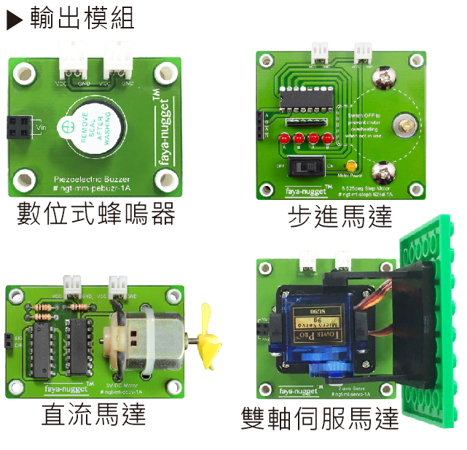
faya-nugget
Output Module
Piezoelectric Buzzer
Step Motor
DC Motor
2-axis Servo

Slide 11
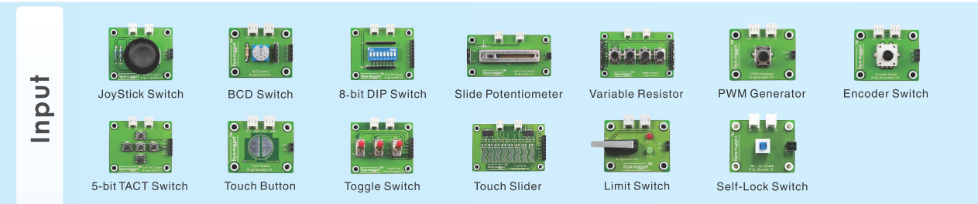
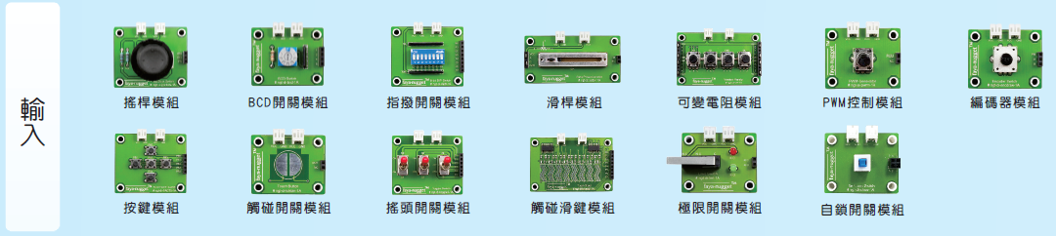
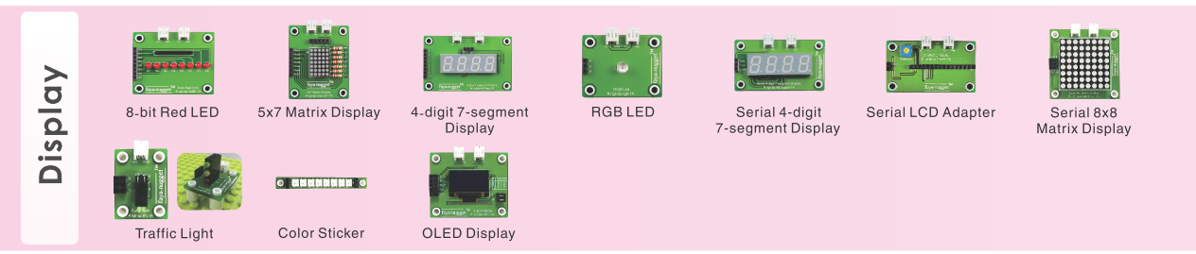
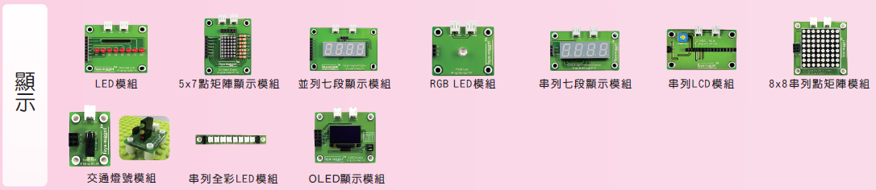
faya-nugget

Slide 12
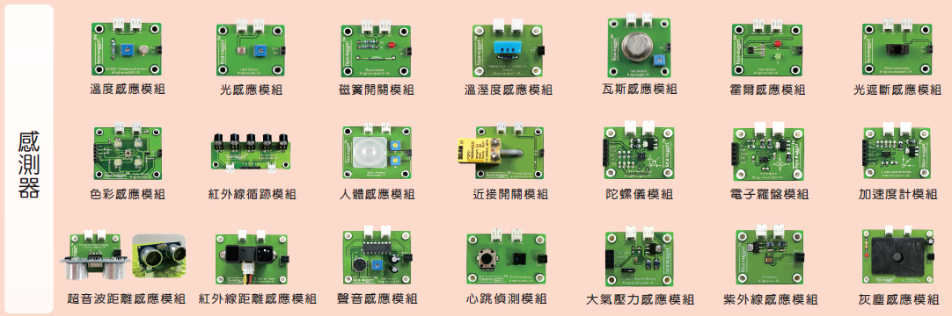
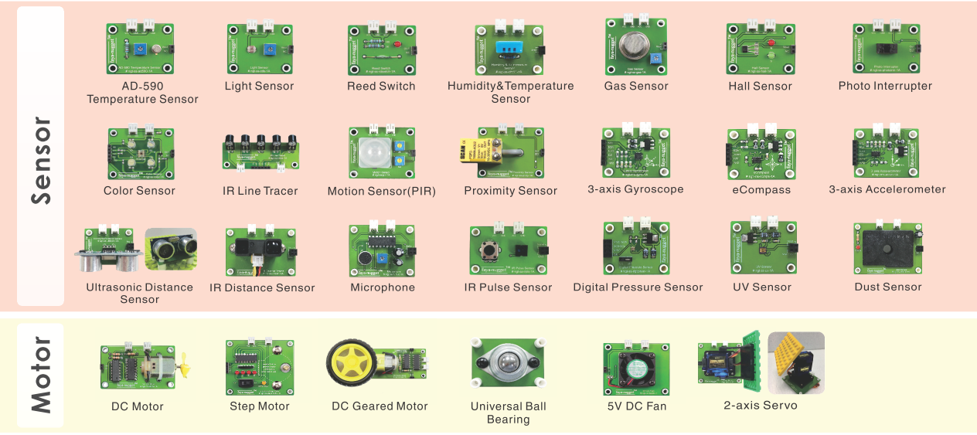
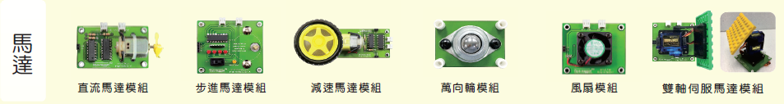
faya-nugget

Slide 13
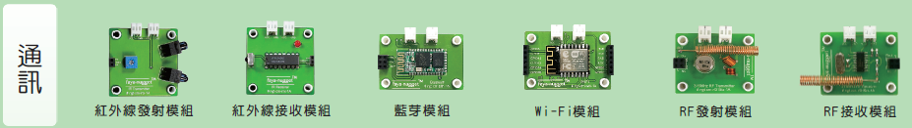
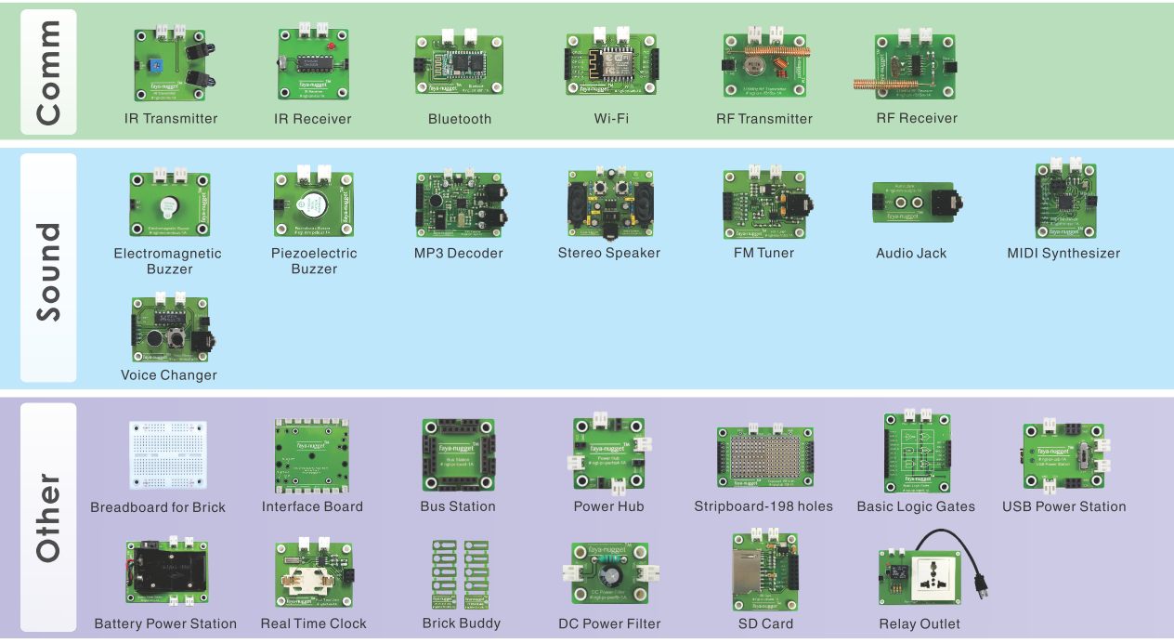
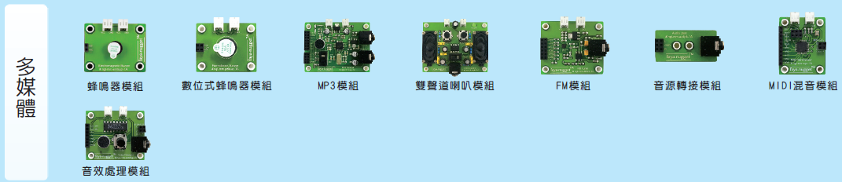
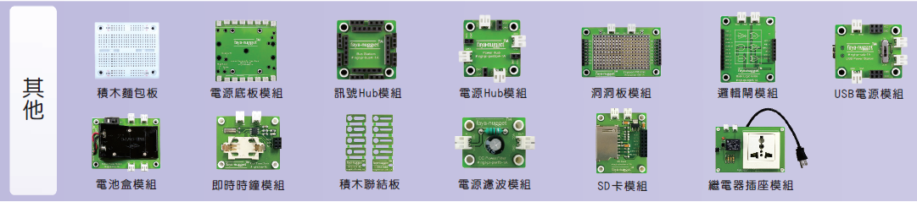
faya-nugget

Slide 14




Software support

Slide 15
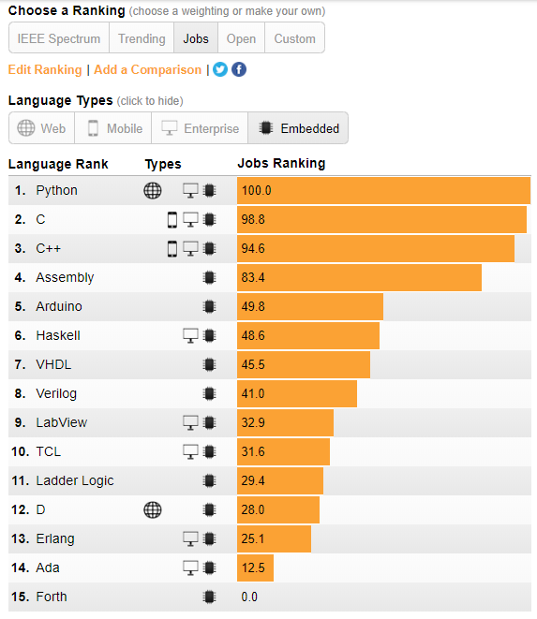
Program language ranking

Slide 16
Why Python?
The braces "{}" are replaced by line breaks and indents.
It is simple and beautiful.
It can be used across-platforms.
It can be executed directly without compiling.
It has many third-party libraries.

Slide 17
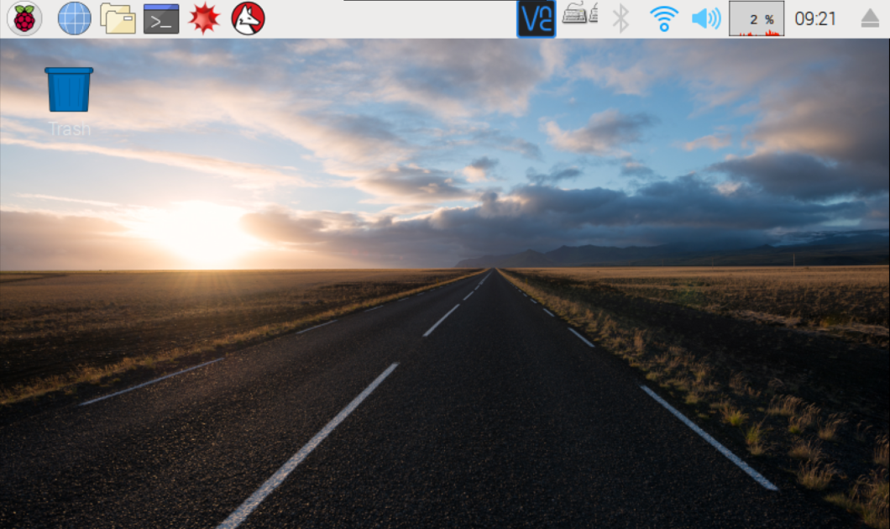
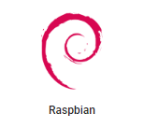
Operation System
Start
開始
Browser
瀏覽器
File Manager
檔案總管
終端機
Terminal

Slide 18
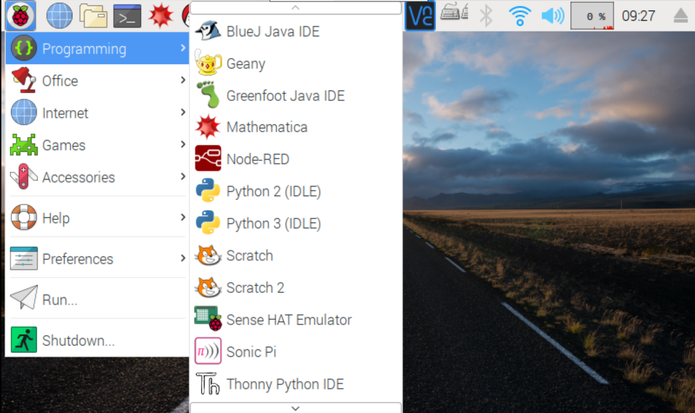
Operation System

Slide 19
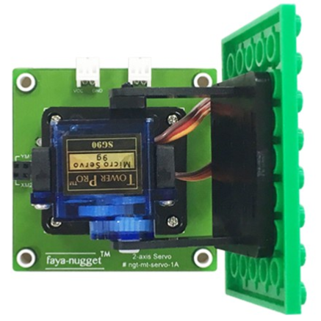
Experiment example
Course Description: faya two-axis servo motor module
Learning Objectives: Understand the functions and usage of the faya two-axis servo motor
Expected learning time: 30min
Demonstration module : faya two-axis servo motor module faya joystick switch module

Slide 20
Features
The faya two-axis servo motor module is composed of two servo motors. The servo motor has a DC motor, a gearbox, and a control circuit, all of which are packed in a blue plastic box. The power, ground, and control pins are drawn, and the angle of the control handle above the gear can be operated (up to 180 degrees) as long as the control signal is used in accordance with the rules.
Please note:
The wiring sections for signal/power/ground, are colored in orange/red/brown, respectively. please connect to the PWM / VCC / GND on the panel.

Slide 21
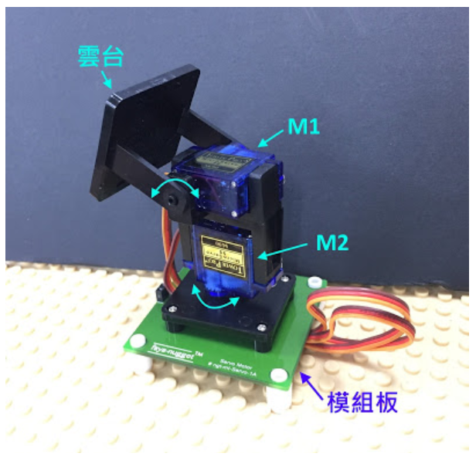
Features
The panel of the faya dual-axis servo motor module is shown below:
the module has two input ports, YM1 and XM2, which are used to control the M1 motor (Y axis) and the M2 motor (X axis) respectively. The format of the input signal is PWM, which will be introduced.
When inputting the PWM signal to YM1 port, the motor above M1 can be controlled.
When inputting the PWM signal to YM1 port, the motor under the M2 can be controlled.

Slide 22
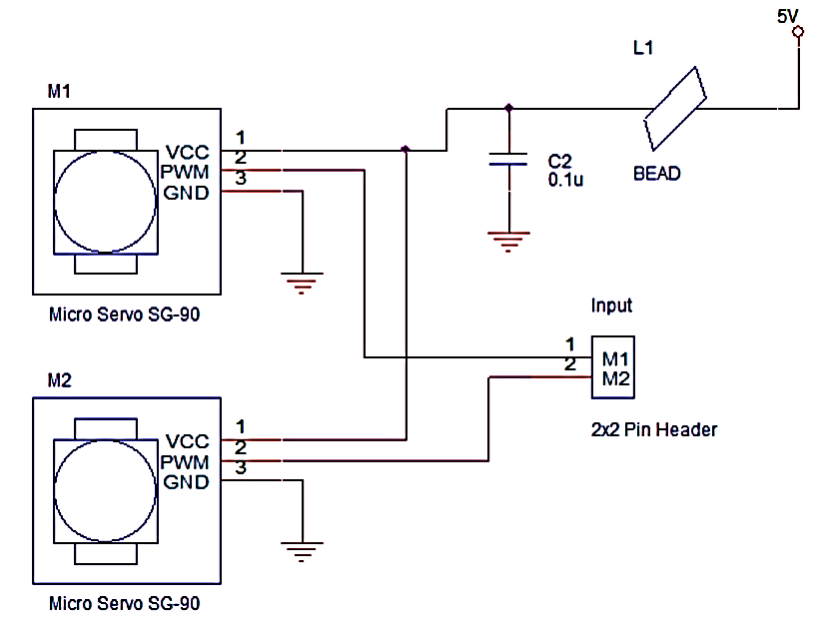
Principle knowledge
The circuit diagram for the faya dual-axis servo motor is shown below: apart from the external capacitor and bead anti-power noise, there are a power, ground and two motor signal lines located on the input ports YM1 and XM2.

Slide 23
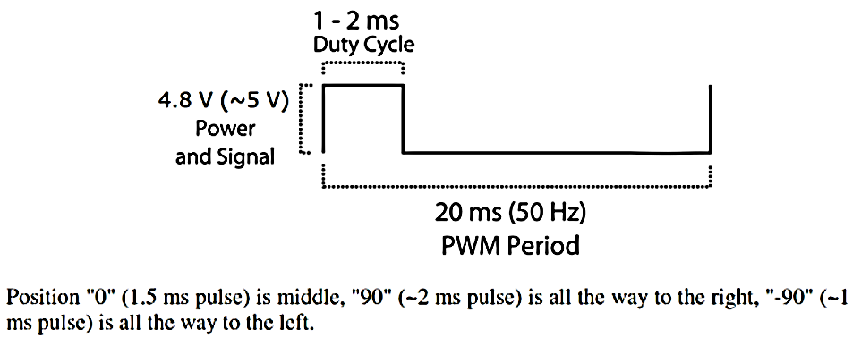
Principle knowledge
The servo motor SG90 controls the rotational position through the PWM pulse signal. The frequency of the signal is 50 Hz, i.e. the pulse width of 20 ms. By changing the pulse width, the final stop position of the motor can be adjusted.

Slide 24
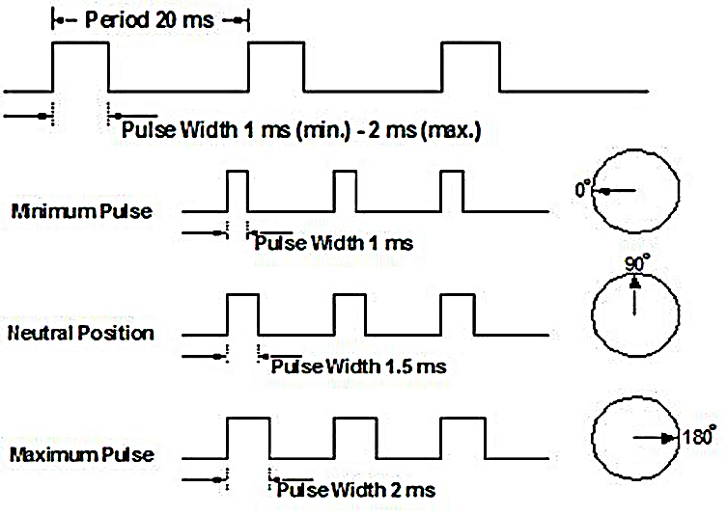
Principle knowledge
From the datasheet, the control angle is 180 degrees (-90 ~ 0 ~ 90). From the leftmost -90 degrees to the rightmost 90 degrees, the relative pulse width is about (1ms ~ 1.5ms ~ 2ms).

Slide 25
Implementation
Target:
To control the faya two-axis servo motor module by the faya analog joystick switch module.
Wiring:
Power cord connection
Pi POWER ===> Two-Axis servo motor module (VCC)
Pi POWER ===> Two-axis servo motor module (GND)
Pi POWER ===> Joystick switch module (VCC)
Pi POWER ===> Joystick switch module (GND)
Signal connection
Pi pin12(IO18) ===> Servo_Motor YM1
Pi pin35(IO19) ===> Servo_Motor XM2
Pi right side AI0 ===> JoyStick_Switch VRX
Pi right side AI1 ===> JoyStick_Switch VRY

Slide 26

Implementation
Click on the Raspberry Pi icon:
Start > Programming > Python 2 (IDLE).

Slide 27
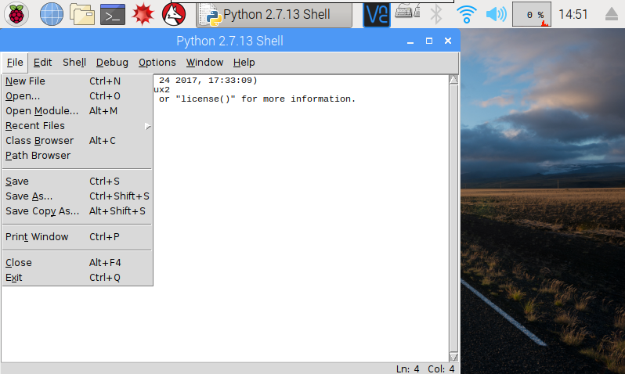
Implementation
After opening, click File>New File

Slide 28
Implementation
Type the following program in the New File, and pay attention to the paragraph.
# Import library
import time
import smbus
import pigpio
# Set the I2C address and the address of Analog In
address=0x49
AI0=0x40
AI1=0x41
#Initiate I2C
bus=smbus.SMBus(1)
# Pin definition: the actual pin is 12, 35, corresponding to GPIO18, 19
YM1=18
XM2=19
# Set the PWM frequency
PWM_FREQ=50
#Use PIGPIO
pi=pigpio.pi()

Slide 29
Implementation
#Set functions
def SetAngleX(angle):
duty_cycle = int((500 * PWM_FREQ + (1900 * PWM_FREQ * angle / 180)))
return duty_cycle
def SetAngleY(angle):
duty_cycle = int((500 * PWM_FREQ + (1900 * PWM_FREQ * angle / 180)))
return duty_cycle

Slide 30
Implementation
#Main Program
try:
while(1):
bus.write_byte(address,AI0)
bus.read_byte(address)
VRX=bus.read_byte(address)
value_x=(((VRX-0)*(180-0))/(255-0))+0
pi.hardware_PWM(XM2,PWM_FREQ,SetAngleX(value_x)) # Setting hardware PWM
print "VRX:",VRX,
print "value_X:",value_x,
bus.write_byte(address,AI1)
bus.read_byte(address)
VRY=bus.read_byte(address)
value_y=(((VRY-0)*(180-0))/(255-0))+0
pi.hardware_PWM(YM1,PWM_FREQ,SetAngleY(value_y)) # Setting hardware PWM
print "VRY:",VRY,
print "value_Y:",value_y
except KeyboardInterrupt:
print('STOP')
finally: # When stopped, the PWM is set to INPUT
pi.set_mode(YM1,pigpio.INPUT)
pi.set_mode(XM2,pigpio.INPUT)

Slide 31
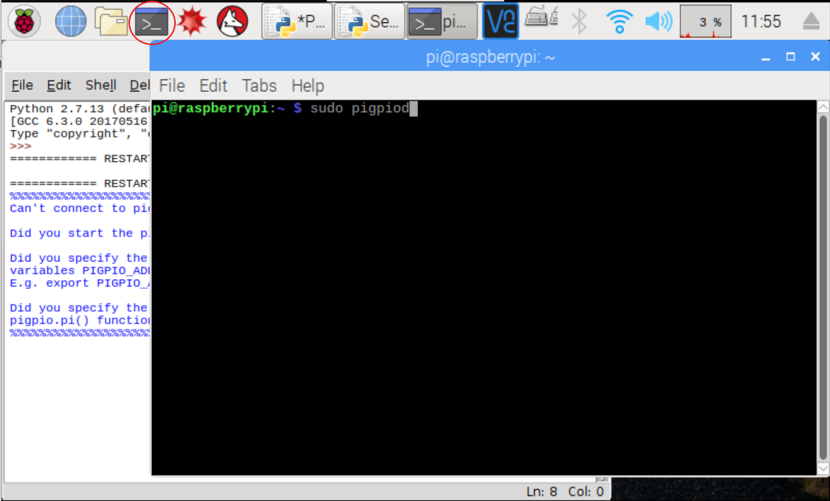
Implementation
After the input is completed and saved, the file is named: Servo_Motor.py, please open the terminal and input sudo pigpiod and press ENTER to enable the hardware PWM function.

Slide 32
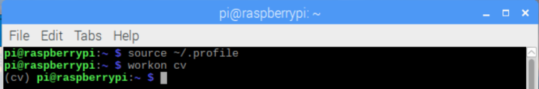
Implementation- with camera
Open the terminal and type source ~/.profile and enter workon cv

Slide 33
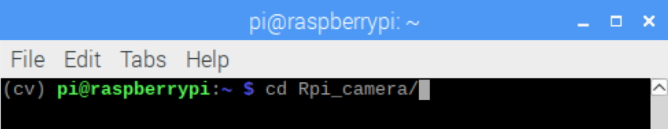
Implementation- with camera
Then type cd Rpi_camera/ and press ENTER to enter the directory.

Slide 34
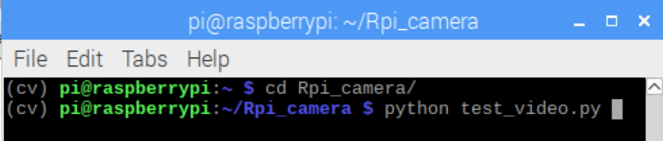
Implementation- with camera
Then type python test_video.py, and press ENTER to open Camera.

Slide 35
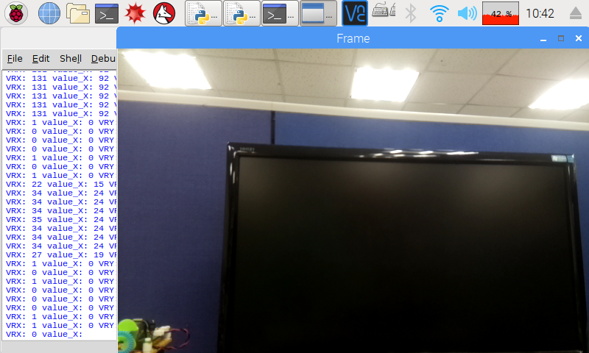
Implementation- with camera
To end the camera, please click on the red circle and press CTRL+C to stop Camera.

Slide 36


